Slide 1
Session 2
Building Sustainable Partnerships
Jeff Trzeciak

Slide 2
Building Partnerships
Jeffrey Trzeciak
HKUL Leadership Institute 2018
Hong Kong

Slide 3
Outline
Introduction
Context for Collaboration
Context for Innovation
Building on strengths
Building successful partnerships
Real World Example: Seizing on opportunity
Exercise

Slide 4
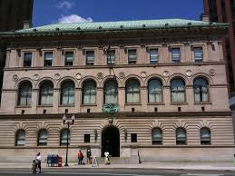
Introduction
Director, Newark Public Library
Largest city library in New Jersey, serving NJ’s largest city
More than 430,000 visitors last year
Significant special collections
African-American History
Latino Community in NJ
30,000 works of art
Philip Roth Personal Library

Slide 5
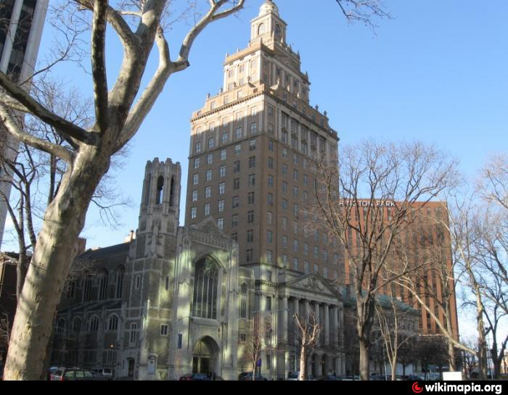
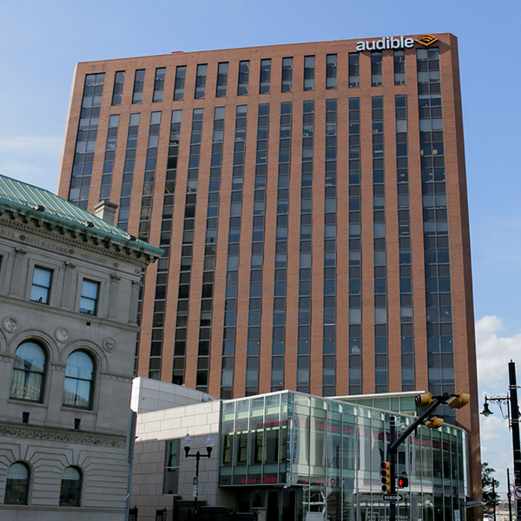
Context for Collaboration

Slide 6
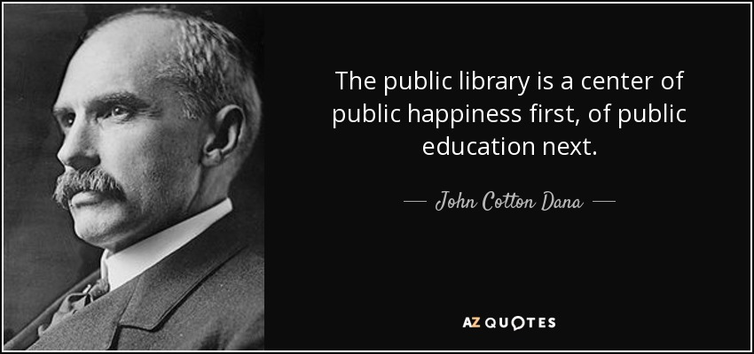
Context for Innovation
Notes:
Long standing history of innovation including first business library in the US, open stacks and first foreign language collections for immigrant communities

Slide 7
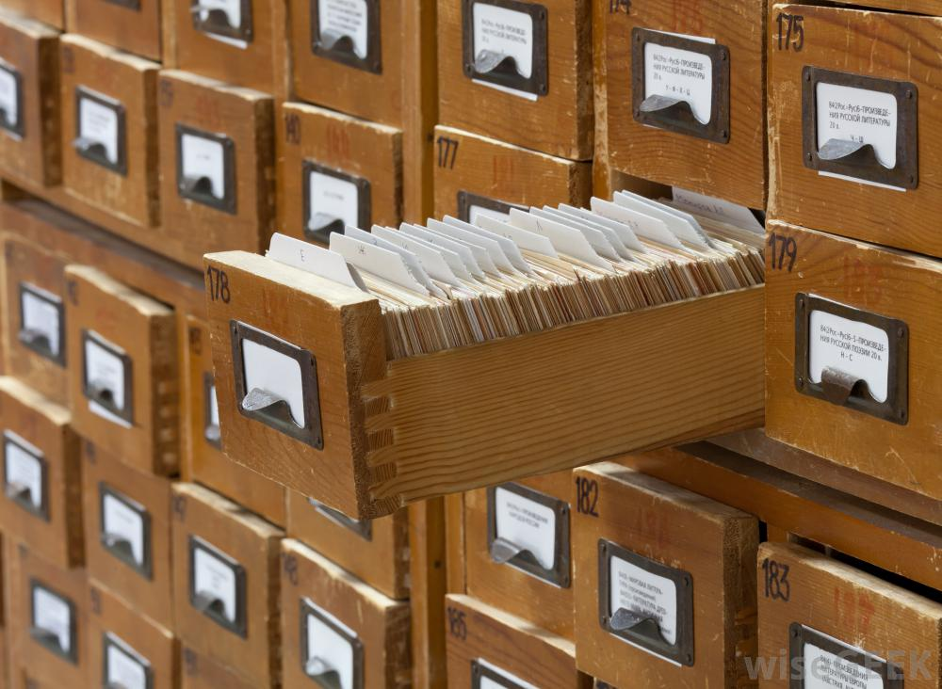
Building on our strengths: Our traditional core
Stewardship
Discovery
Preservation
Education
Celebration

Slide 8
Building successful collaborations
Rosabeth Moss Kantor, a researcher at Harvard Business School has identified the characteristics of successful partnerships (Kanter, 1994).
Individual excellence, in that the partners are strong and have something to contribute to the relationship.
Importance, in that the relationship fits the strategic objectives of the partners and they want to make it work.

Slide 9
Building successful collaborations
Rosabeth Moss Kantor, a researcher at Harvard Business School has identified the characteristics of successful partnerships (Kanter, 1994).
Interdependence, in that the partners need each other and have complimentary assets and skills.
Investment, in that the partners are willing to show tangible signs for a long-term commitment.

Slide 10
Building successful collaborations
Information sharing, in that communication is open and critical data is shared freely.
Integration, in that the partners develop linkages and share in joint activities.
Institutionalization, in that the relationship may adopt a formal status with clear responsibilities and decision processes.
Integrity, in that partners behave towards each other in honorable ways that justify and enhance mutual trust.

Slide 11
Seizing Opportunity
Notes:
This exhibit was curated by students in Dr. Mary Rizzo's American Studies and History class, Place, Community and Public Humanities at Rutgers University-Newark, in collaboration with a graphic design class, a team of community advisors, the Newark LGBTQ Community Center, and the Rutgers-Newark LGBTQ & Intercultural Resource Center. On display at the Newark Public Library

Slide 12
Aims: Queer Newark Oral History Project
Interview the full diversity of members of Newark’s LGBTQ community;
Engage college and university students and faculty in interviewing, cataloging, transcribing, publicizing, organizing, and performing other tasks that will facilitate the growth of the QNOHP;
Cement collaboration between Newark’s LGBTQ political, service, and faith organizations and Newark and Newark-area colleges and universities with the QNOHP;
Encourage LGBTQ Newark and former Newark residents to donate their papers and other artifacts to our growing collection of Queer Newark.

Slide 13
Goals
To interview people whose lives connect to the history and experiences of LGBTQ Newark;
To transcribe interviews so that they are searchable and easily usable for community members, activists, scholars, artists, or anyone interested in Queer Newark;
To preserve interviews, as well as whatever papers and artifacts we can collect about Queer Newark, in a permanent, catalogued, archival);

Slide 14
Goals
To make interviews and artifacts accessible through digitization;
To collect, catalog, and make accessible existing interviews of LGBTQ Newark residents and former residents.

Slide 15
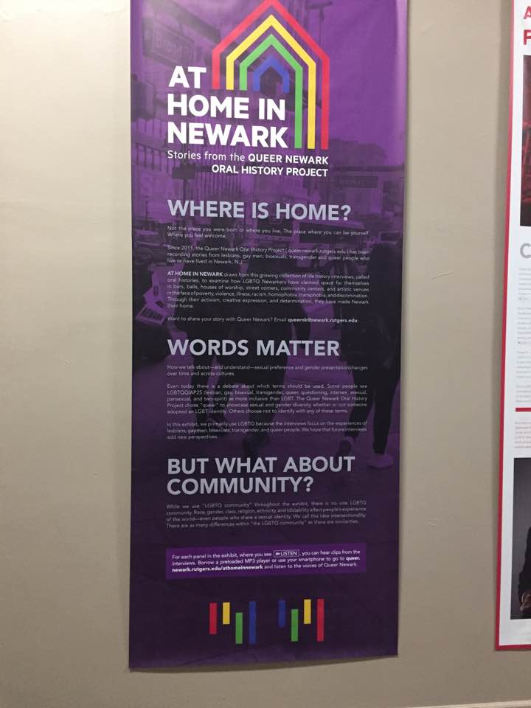
Stewardship
The Queer Newark Oral History Project (QNOHP) was founded in the summer of 2011 by
Darnell Moore, an activist and writer
Beryl Satter, a history professor at Rutgers University-Newark, and
Christina Strasburger, the administrator of the Departments of History and African American and African Studies at Rutgers University-Newark.
collect and preserve the history of LGBTQ and gender-nonconforming communities in Newark

Slide 16
Discovery
Threefold commitment:
public programming,
academic research, and
the development of a publically accessible archive of oral history interviews and documents
Project staff have
Recorded interviews with queer Newarkers about their lives.
Conducted extensive research in manuscript and periodical collections across the region
Created an extensive, public bibliography of rare primary sources and historical studies
Created and distributed a historical timeline of queer club spaces in Newark; and
Published both traditional peer-reviewed scholarship and online public history.

Slide 17
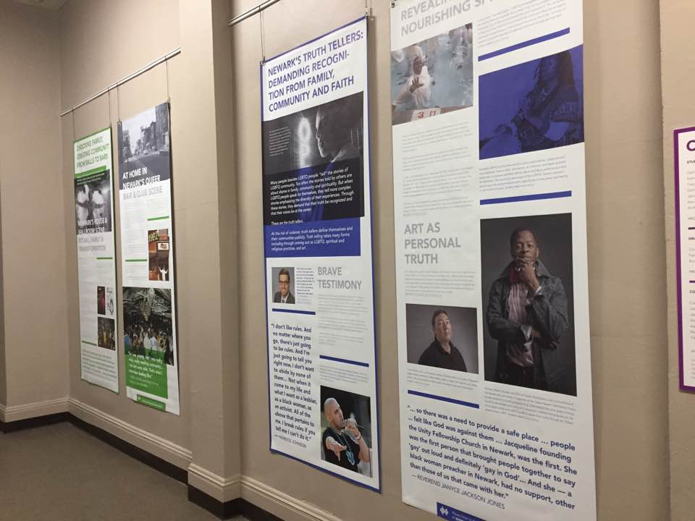
At Home in Newark: Stories from the Queer Newark Oral History Project
2017
Project collaborators
Newark Public Library (host)
Rutgers University – Newark
Public Humanities
Graphic Design
LGBTQ & Intercultural Resource Center
Newark LGBTQ Community Center

Slide 18
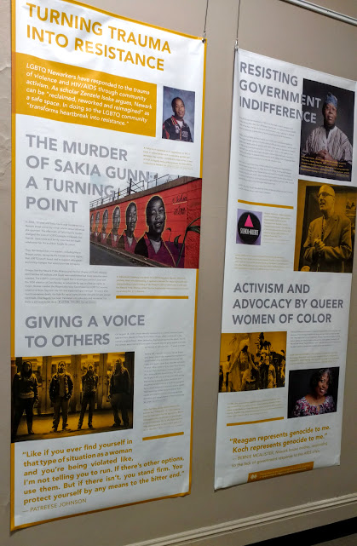
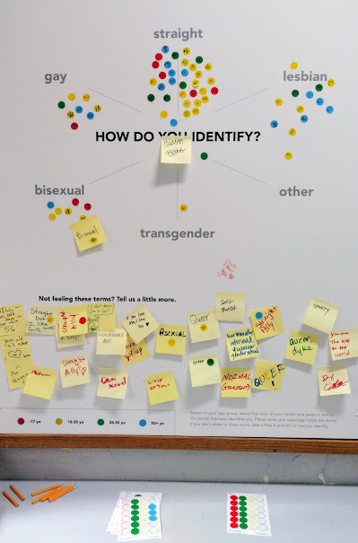
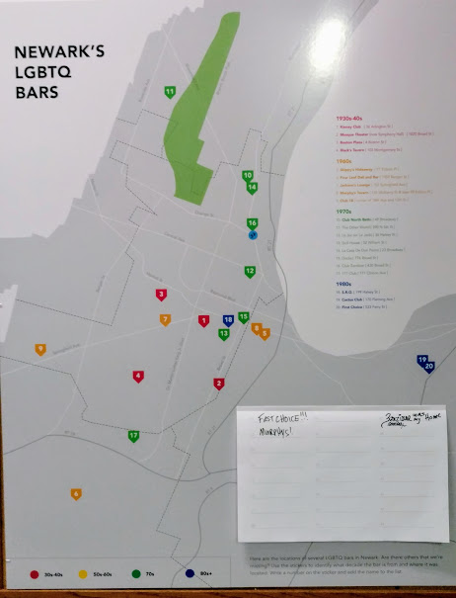
At Home in Newark: Stories from the Queer Newark Oral History Project
Notes:
OUTCOME: Exhibit

Slide 19
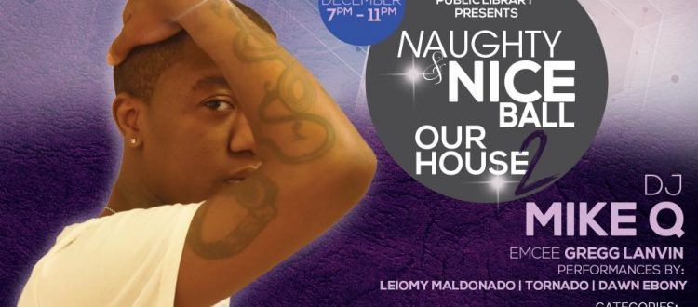
Recognizing opportunity: Celebration

Slide 20
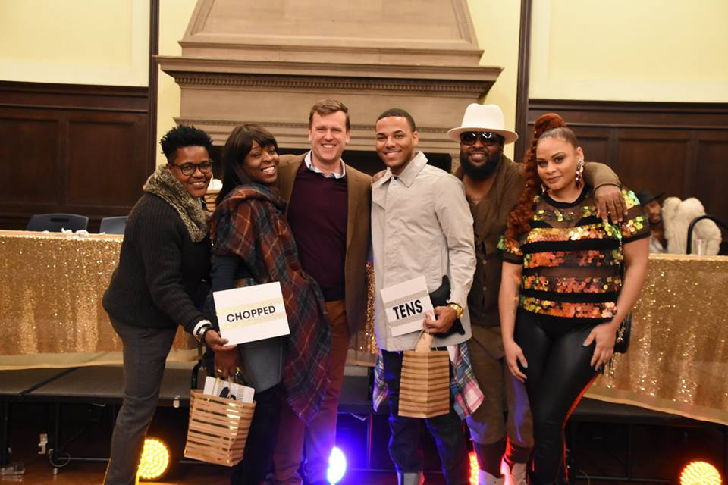
Recognizing opportunity: Celebration

Slide 21
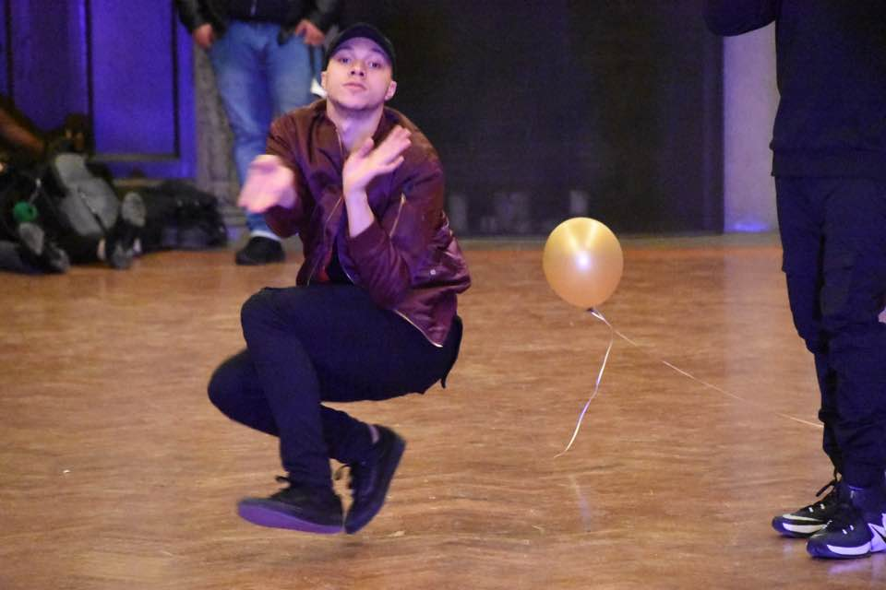
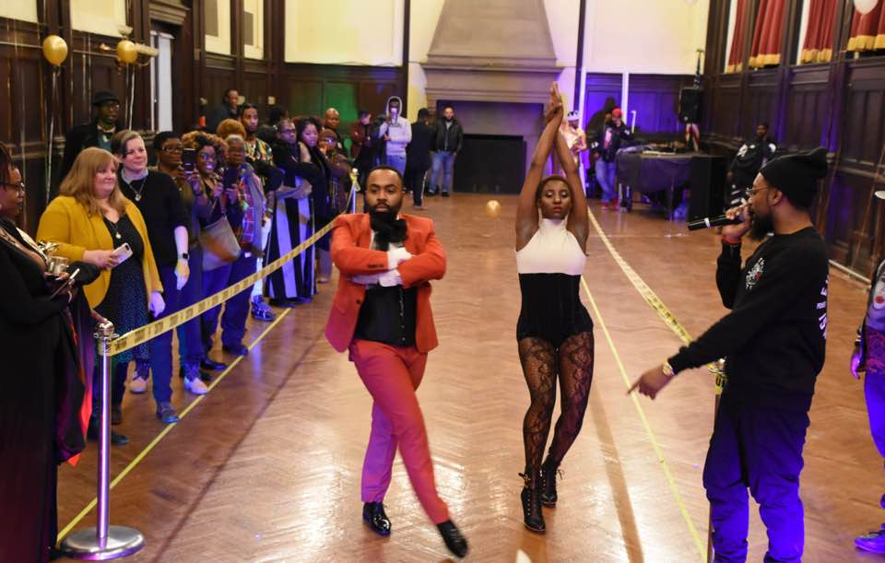
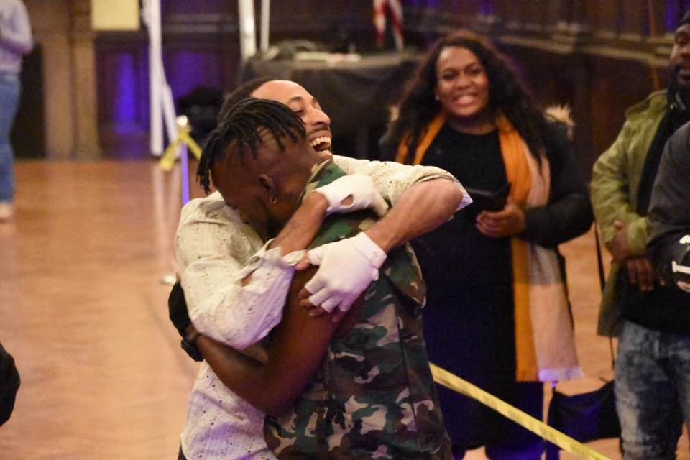
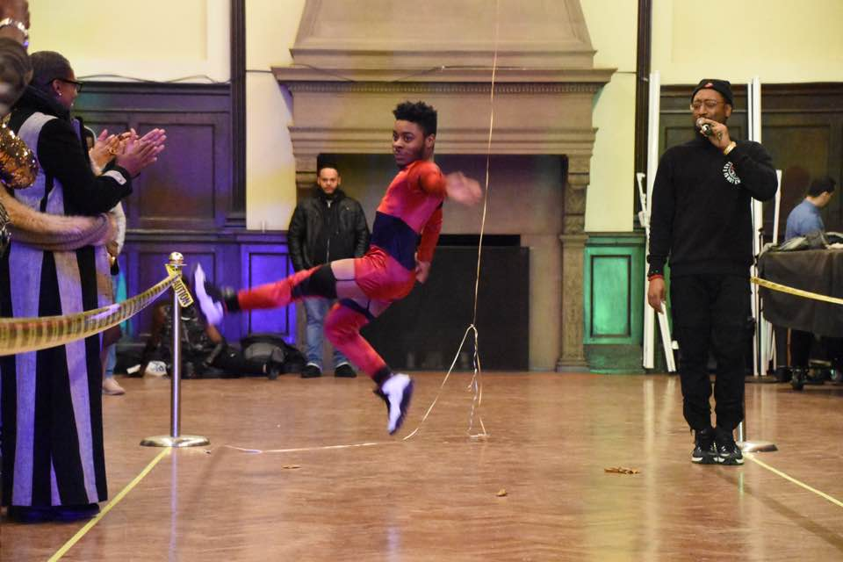
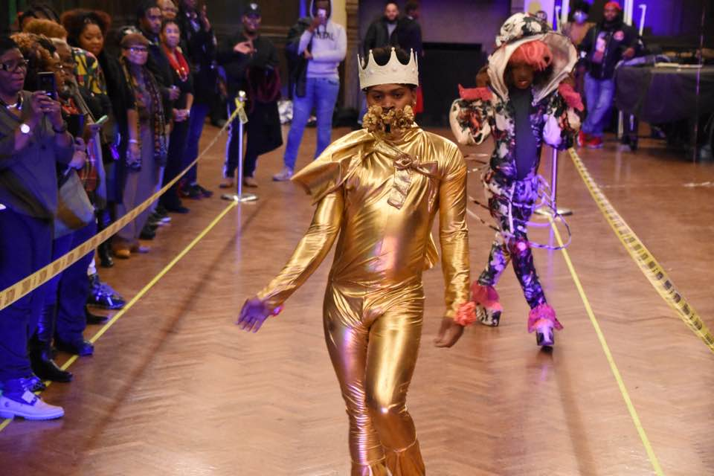
Recognizing opportunity: Celebration

Slide 22
Exercise
Identify areas of strength that each of you have. Are there common themes?
Identify areas of weakness that each of you have? Are there common themes?
Are there opportunities where you could work together?
How might you explore these relationships after this workshop?

